Slide 1
Learner Success Model Development (LSM) Process
(Jan 2013)
Opoku Adu-Gyamfi
Marketing Analytics

Slide 2
About Learner Success Model(LSM)
The Learner success model (LSM) is an attempt to predict prospective learner’s likelihood of succeeding and persisting through graduation at the point of inquiry
Learners’ success and persistence is perceived to be a person’s ability to succeed and complete certain threshold of prescribe course sequence in an academic program
The model is an equation with a finite number of input attributes that assign prospective leaner a score ranging between 0 to 100, the higher the score, the better the prospect learner.
Attributes on inquiries coming through our inquiry systems (Seahawk) are collected and routed through the model to assign a score
The model was developed and implemented the beginning of third quarter of 2011. The model is due for update as it’s approaches it’s life span (18-24months)

Slide 3
Cont’d: About Learner Success Model(LSM)
The model as is right now is relevant to inquiries from continental USA as it includes credit bureau data and other Zip code level aggregates applicable to only US residents
Application of the model is enormous. At a minimum:-
  It can be used in guiding decision making e.g. Contact strategies around who an EC should be talking to, and spending their limited time resources
  Guiding principle for the media team on which media channel they should be targeting
  As a leading indicator on Lead/inquiries quality trend
Given the for-profit nature of our business in higher education it is important to have systematic processes in place of attracting quality learners in the first place, desirably at the point of inquiry. The model helps in that aspect by picking crème of the crop inquiries.
Specific marketing programs e.g. contact strategies targeting certain model segment helps alleviate unbearable consequences of higher dropout. Having differential treatment for each model score segment optimizes our scarce resources.

Slide 4
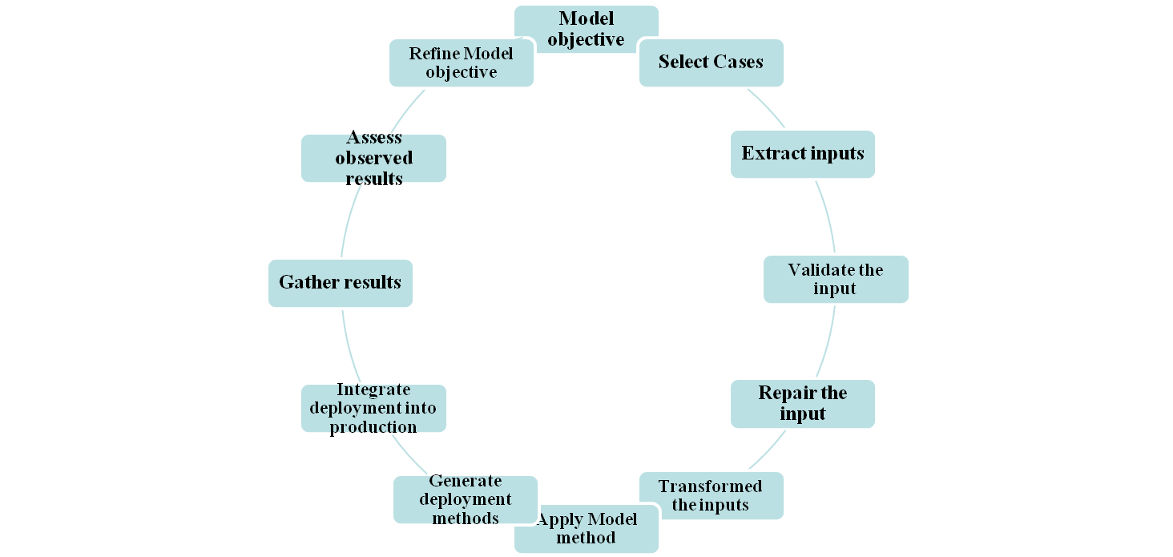
Model Development Process
Model development is a systematic process encapsulating sequences of steps which are mostly iterative depending on outcome.

Slide 5


Model’s Objective
This objective is usually business driven and most of the time try’s to solve a business problem or enhanced business process.
The primary objective of the LSM is to identify prospective learners who would most likely succeed and persistent through program completion and graduate. The outcome of the model is a ranking of prospective learners on a scale of 1 to 10 (1 being most likely outcome 10 being least like group )

Slide 6
Selecting Cases
Cases for the LSM model includes all learners that started in Q1 2011 – Q3 2012 cohorts. The decision around this time frame was to have each quarter’s enrollment represented in the sample to avoid converted seasonality issues if present in enrollment patterns.
Learners in each cohort was track to determine who succeeded and persistent after they enrolled.
The LSM practical definition of learners success and persistence was:-
  Leaner's with Cumulative GPA greater than or equal to 3.00 for PHD & MS Learners, 2.00 for Undergraduates
  And have cumulative earned credits equal to or above 50th percentile of their cohort class. For undergraduates, additional criteria for passing a First Course success was applied
  Learners fulfilling these requirements are classified as Success and Persistence (1) and those unable to fulfill this requirement are classified as Non Success and Non Persistence (0). The distribution of the success vs. non success in the PHD LMS model was 57% vs. 43%.
Twelve months inquiry activities were collected on theses individuals prior to enrollment to enable modeling at the inquiry level.

Slide 7
Extracting inputs
Input data in the LSM consistent of inputs that could be classified as :-
  Demographics e.g. Age, Gender, Race and etc..
  Behavior e.g.. Prev. online edu exp, Prev. Coll exp, academic success history etc.
  Geographic e.g.. Regions/Divisions/Urban vs. Rural and etc…
  Financial & Credit worthiness e.g.. Income, Student loans debt & Utilization, Tax info
  Academic interest and Employment History
  Visitors center activities e.g. # of visits, Duration, Time of day of visit (not yet incorporated)
  Social Media e.g.. Interest in online education, Face book, LinkedIn etc..
Sources for all these input data come from:
  Census 2000 (External data subscription)
  Geo Analytics Demographic (External data subscription)
  Experian (External data subscription)
  Rapleaf (External data subscription)
  Lead forms (Internally captured)
  Strategic Research and Analytics team(Internal)

Slide 8
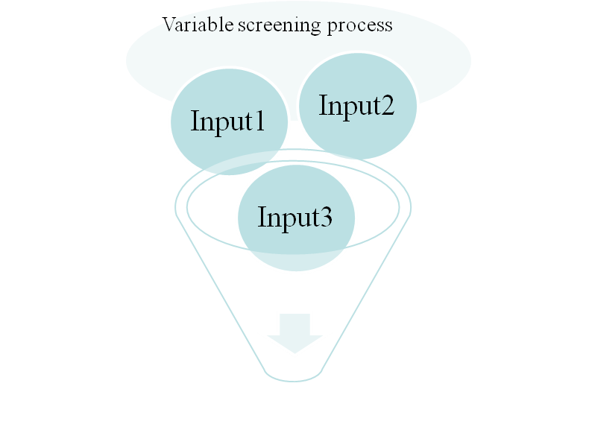
Cont’d : Extracting inputs
All these variables are funneled through variable screening process to eliminate redundancies.
Among the many Variable screening methods is Factor analysis.
Failing to remove redundant variables is a serious problem for certain modeling method example Regression. They cause inflation in parameter estimate leading to over fitting and instability of the model for decision making ,prediction or ranking. The general statistical term for this redundant problem is multicollinearity
Factors analysis group related input variables into components and extract the components explaining majority of the variability in the underlying data structure, and selects within each component the dominant variable to represent that component. It’s basically removing redundant variables without any loss of generality in information
Remaining Variables: Input1 & 2

Slide 9

Cont’d : Extracting inputs
After removing redundant variables, the next step in input extraction is to remove irrelevant inputs with no relation to model’s objective.
This stage is not so critical as most of the modeling algorithms have built in processes to insolate irrelevant input variables.
  Example: Regression’s stepwise/forward and backward options remove irrelevant variable unrelated to model’s objective. Decision tree also uses logworth criteria to eliminate irrelevant inputs

Slide 10
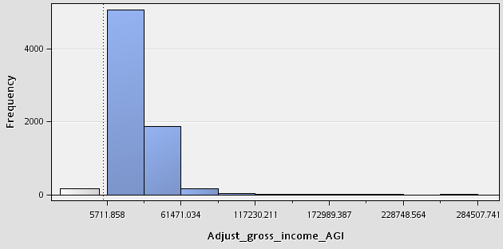
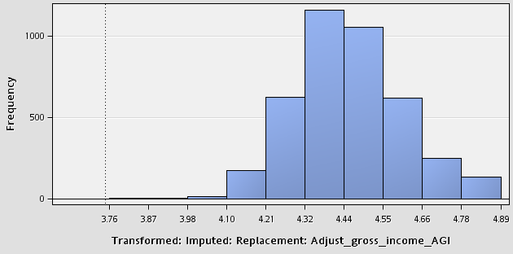
Explore/Validate and Repair selected inputs
This stage involved understanding underlying distribution of each selected inputs for:-
  Normality, uniformity and skewness,
  Range or standard deviation of inputs to detect outlying data points,
  And finally the possibility of missing data points. Certain modeling algorithms are very sensitive to these issues e.g.. Regression and Neural Network .
Outlying data points
Median imputation
Removed outliers three standard deviation from mean
Apply Log to base 10 transformation to normalize the data
Missing data points
Right skewed distribution
Before repairs
After repairs and Transformation

Slide 11

Splitting Modeling Dataset
Split the modeling dataset into two part:-
  Training - This dataset is used to estimate the model’s parameters
  Validation - This is use to test and calibrate the parameter estimate and also used to select the ultimate model using fit statistics on the validation dataset.
  There should be little separation between the training estimates and the validation estimates. Huge separation is an indication of model over fitting
Validation Sample ~ 45%
Training Sample 50%

